Slide 1

CO2 Emission and Health challenges in Africa: A Comprehensive Analysis
Shail Jayla
Srujana Eleena

Slide 2
Index
Introduction
Hypothesis
Methods
Analytical Results
Conclusion
Process
Suggestion for improvement
Tools and Dataset

Slide 3
Introduction
In the phase of a global climate changes and challenges, there is an urgent need to understand and address factor contributing to rising carbon dioxide emissions. Africa is a is a developing continent and hence makes it no exemption to rising CO2 level.
In this comprehensive project, our primary objective is to illuminate the current state of carbon emissions across the African continent.
By delving into the nuances of diverse industries, energy sources, and socio-economic factors, our aim is to pinpoint the key drivers of CO2 emissions.
This initiative goes beyond identification; it is a concerted effort to propose sustainable solutions that can effectively mitigate the impact of carbon emissions on the continent.

Slide 4
Hypothesis
The hypothesis for this study is that CO2 emissions in Africa are on an upward trajectory, primarily driven by increased energy consumption, industrial activities, and deforestation. We anticipate that urbanization and population growth are significant contributing factors as well. To test this hypothesis, we will analyze historical CO2 emissions data and explore their correlation with various socio-economic and environmental factors in the African context.

Slide 5

Tools
Pandas
Numpy
Mathplotlib
Seaborn
Geopandas

Slide 6

Area
Population
Transportation
Total CO2 Emission
Other Fuel Combustion
Manufacturing/Construction
Land-Use Change and Forestry
Industrial Processes
Energy
Fugitive Emissions
Electricity/Heat
Bunker Fuels
Buildings
https://www.kaggle.com/datasets/victoraiyewumi/co2-emission-africa

Slide 7
Process
Data Cleaning
Making a Correlation matrix
Drawing Conclusions
Data Collection
Visualize data : Plot different Factors to Co2
Analyzing the Graphs

Slide 8
Methods
Data Collection and Refinement
Correlation Analysis
Visualizing Correlation Patterns
Factor Discovery
In-depth Trend Exploration
Hypothesis Validation and Refinement
Continent-wide Visualization
Conclusion and Project Impact

Slide 9
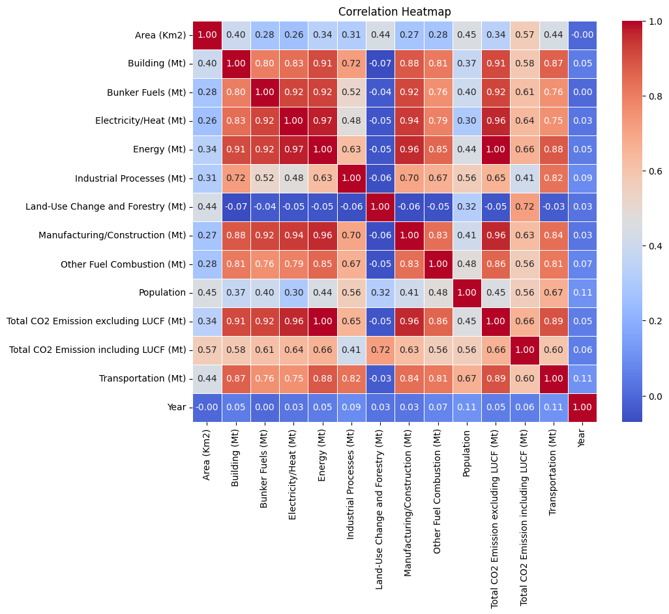

Slide 10
Analytical Results
The outcomes of our study reveal a multifaceted relationship between CO2 emissions in Africa and key influencers such as population, geographical area, and transportation.
The figures and graphs provided offer valuable insights into these relationships, underscoring the significance of our data cleaning and preparation processes in the study.
The graph depicting CO2 emission trends over the two decades (2000-2020) reveals a discernible upward trajectory in carbon dioxide levels

Slide 11
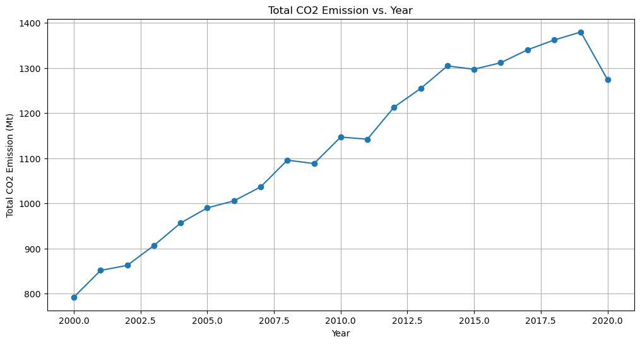
CO2 Emission Trends Over the Years

Slide 12
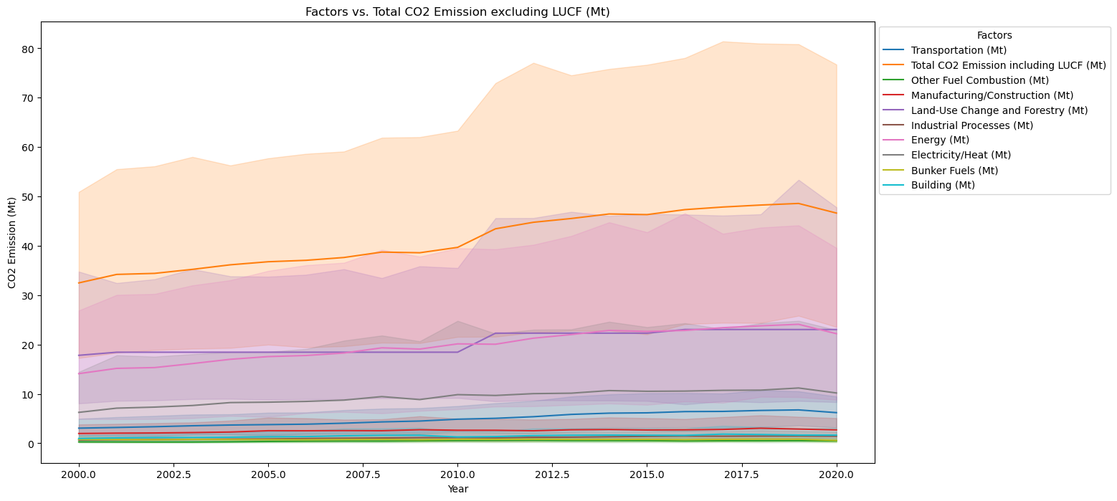
Co2 Emission Factors Over the Year

Slide 13
Energy Vs Total Co2 Emission Correlation
The graph illustrates the correlation between energy consumption and total CO2 emissions, revealing a compelling pattern of a perfect correlation, as indicated by the correlation heatmap.
The upward trend suggests a direct relationship between energy usage and carbon emissions.
The significance of this correlation prompts a deeper investigation into the impact of energy consumption on total CO2 emissions across the studied timeframe.

Slide 14
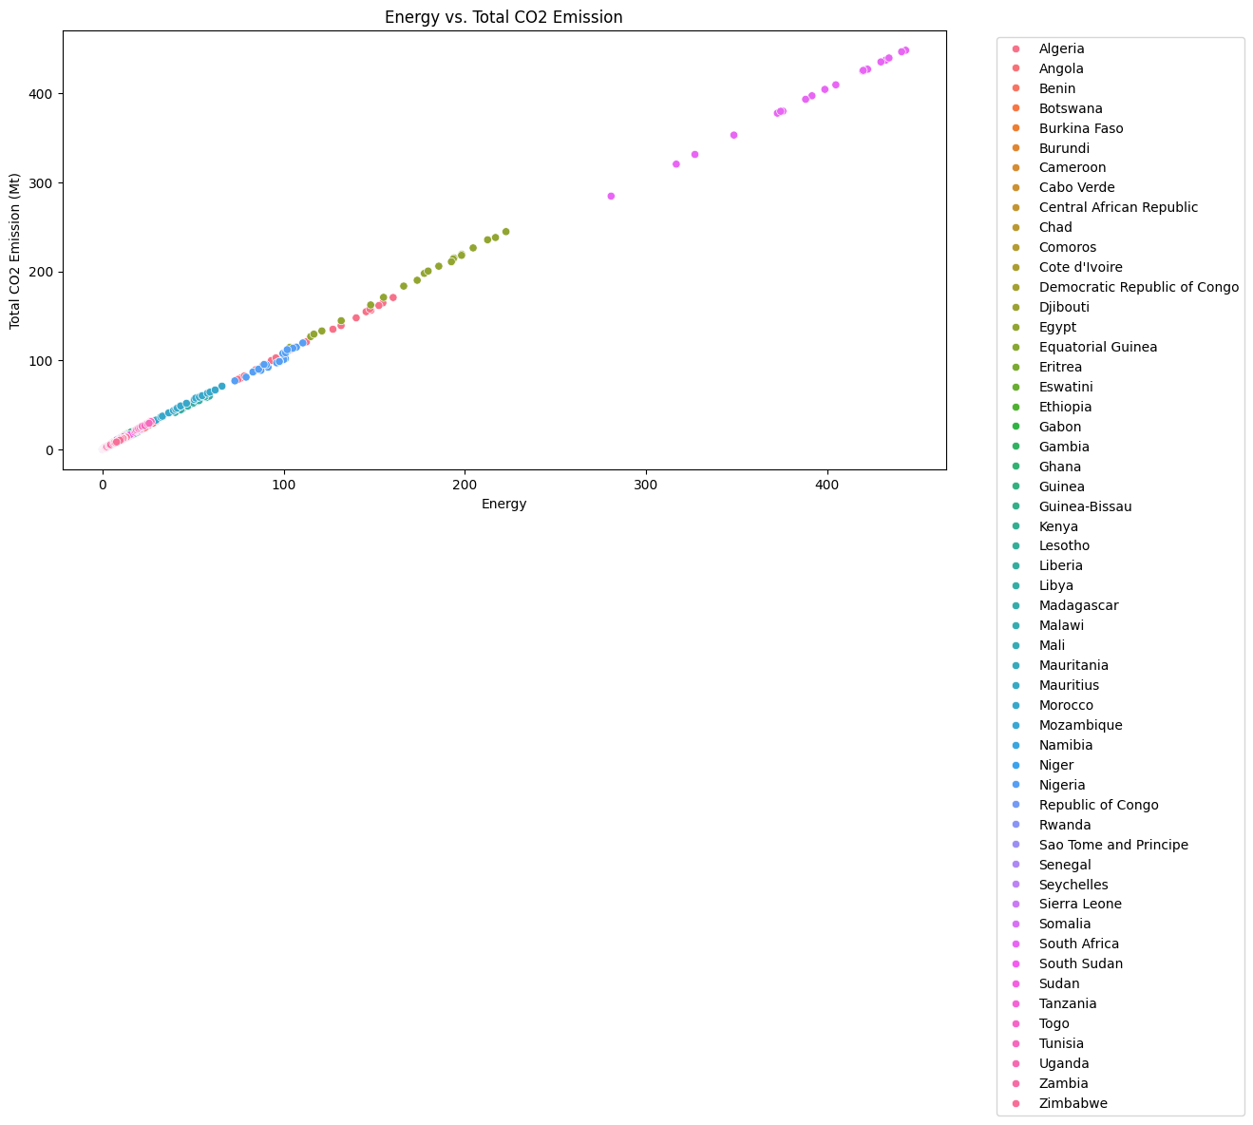

Slide 15
Visualizing Over the Entire of Africa
The map visualization provides a comprehensive overview of CO2 emissions across African countries, arranged in ascending order from least to most emissions.
The color gradient offers a visual representation of the carbon footprint, allowing for a quick assessment of the environmental impact of each nation within the region.
The map visualization serves as a powerful tool for understanding the spatial distribution of CO2 emissions across Africa.

Slide 16
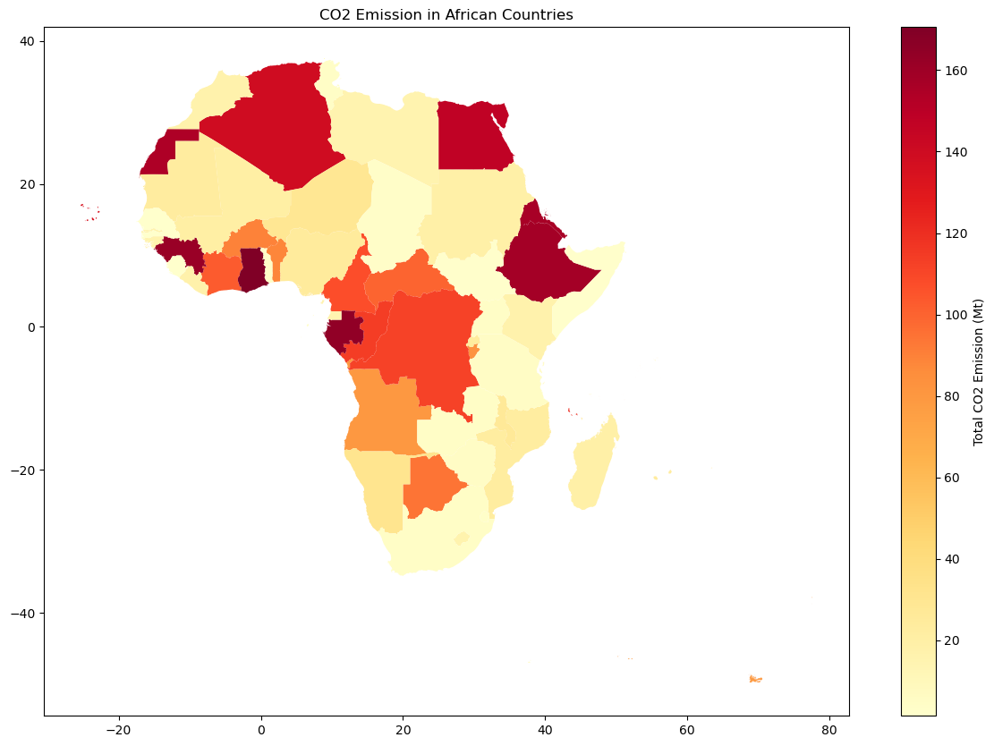

Slide 17
Conclusion
In summary, our extensive analysis of CO2 emissions across 51 African countries over two decades reveals crucial insights into the relationship between environmental factors and carbon dioxide levels.
The study underscores the impact of population density, geographical area, and transportation networks on CO2 emissions, emphasizing the urgent need to address environmental challenges in the region.
The correlation observed between energy consumption and total CO2 emissions emphasizes the interconnectedness of these factors.

Slide 18
Suggestion for improvement
Recognizing this intricate relationship between increased energy consumption, CO2 emissions, and health issues is imperative for developing comprehensive policies.
Addressing environmental challenges necessitates not only a focus on reducing carbon emissions but also a transition to cleaner and more sustainable energy sources.
The study thus serves as a compelling call to action, urging further investigation and policy development to mitigate the impact of CO2 emissions on public health while fostering sustainable energy practices in the region.

Slide 19
Thank You !

